Slide 1
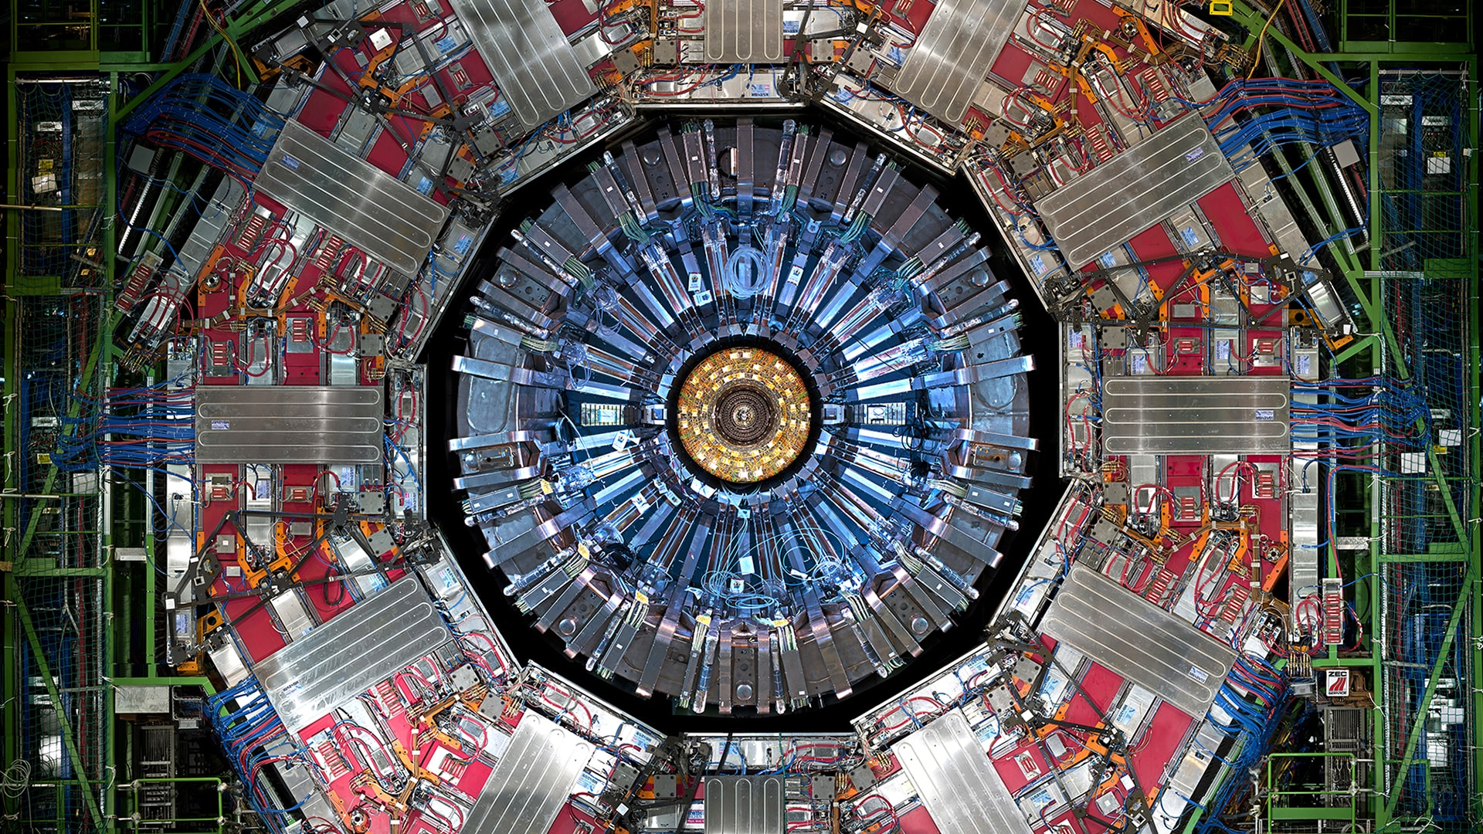
Chapter 1. Introduction

Slide 2
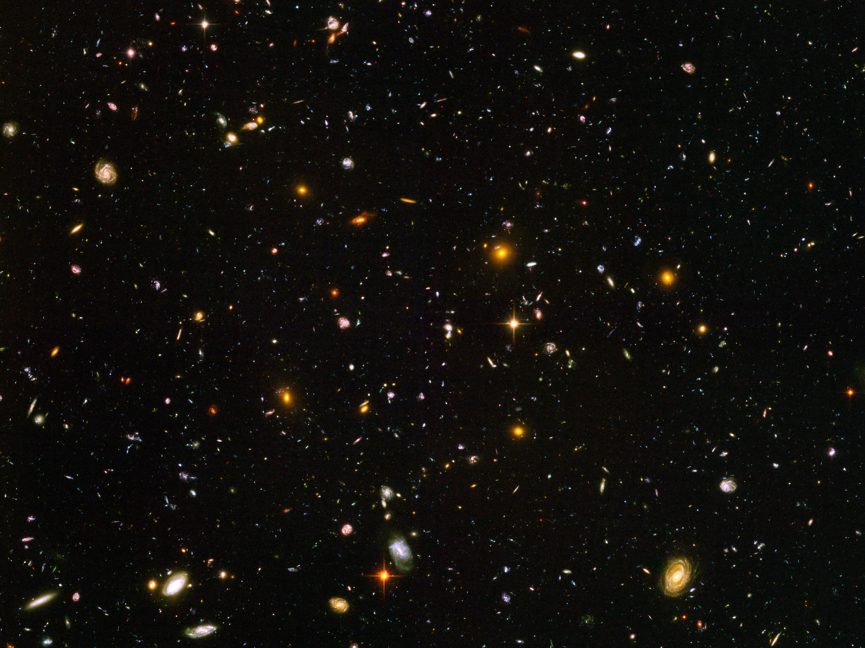

Slide 3
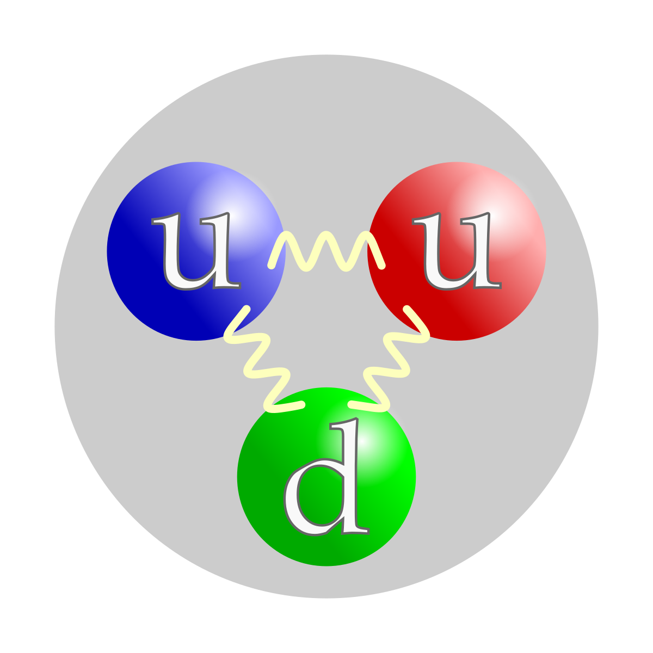
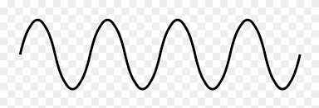
What is Particle Physics?
Subject that studies the fundamental components of Nature and their interactions
Nowadays our knowledge about fundamental particles is condensed in the Standard Model
Experimental foundation:
Collision experiments at higher and higher energies to reveal the features of the particles
Need higher energies to explore smaller and smaller spatial scales
Theoretical foundation:
Quantum Field Theory built on top of Quantum Mechanics and Special Relativity
The history of Particle Physics is the history of achieving larger and larger energies
λ
d
Debroglie:
Wave-Particle duality
Wave properties:
To resolve an object λ ~ d

Slide 4
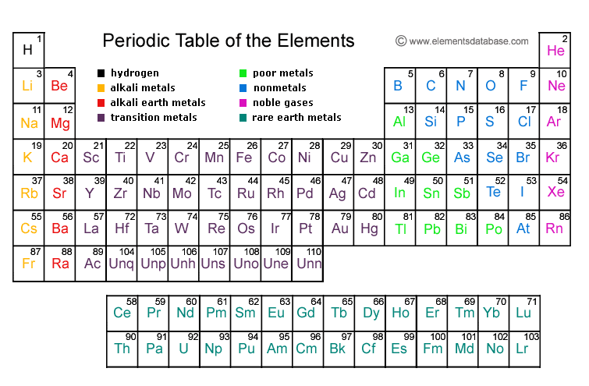
History of Particle Physics: beginnings XIX century
Dalton postulates that all substances might be composed of single units or atoms
As a consecuence of his observations in chemical reaction experiments
In the late 1800 the atoms were being classified according to the properties
This consolidates with the development of the periodic table by Mendeleev

Slide 5
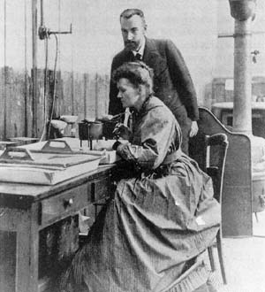
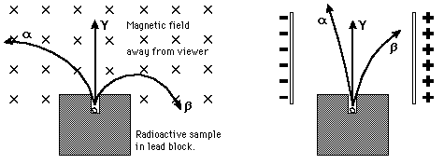
History of Particle Physics: decade of 1890
New unstable elements being investigated by M. and P. Curie, H. Bequerel and E. Rutherford
Radioactivity: spontaneous emission of particles from some species of atoms
At this moment it was determined that there were 3 different kinds of radiation:
Radiation α → 2 electric charge and about 4 times proton mass
Radiation β→ -1 electric charge and about 1/1800 the proton mass
Radiation γ→ electrically neutral

Slide 6
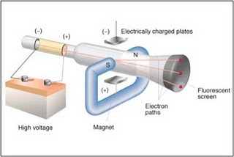
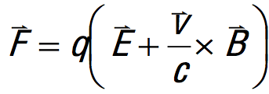
History of Particle Physics: discovery of the electron
For a number of years physicist have generated “cathode rays”
By simply heating filaments inside gas-filled tubes and applying an electric field
In 1987 J.J. Thompson attempted to measure the ratio of charge/mass of cathode rays
Put a cathode ray into a known electric or magnetic field
Measure the cathode ray’s deflection
If they are composed of discrete charges → deflection compatible with Lorentz force
Thompson found that this ratio was ~ 1000 larger than for any known ion
He concluded this was a new kind of particle and named it “electron”
m_{e}= 0.511MeV/c²

Slide 7

History of Particle Physics: Thompson’s atom model
Thompson correctly believed that electrons were fundamental components of the atoms
Since atoms were electrically neutral he postulated that point-like electrons should be somehow embedded in a “gel” of positive charge to yield a global neutral charge
This is the origin of the famous “plum- pudding” atom model
positively charged “paste”
localized electron (negative charge)
Thomson’s plum-pudding model of the atom.

Slide 8
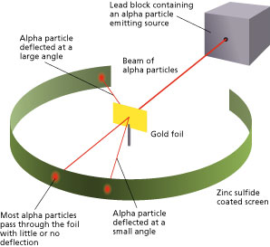
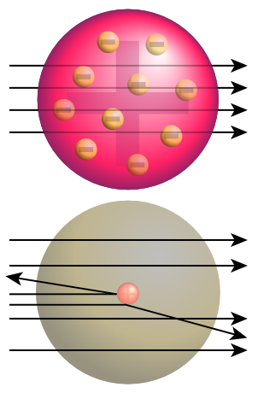
History of Particle Physics: Rutherford’s experiment
In the first years of the XX century E. Rutherford wanted to test Thompson’s model
With this purpose he proposed a setup to make a “scattering” experiment:
Bombing a very thin gold foil with αparticles and observing the deflection
If Thomson’s model was correct theαparticles shold not reflect much

Slide 9
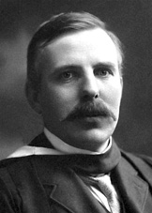
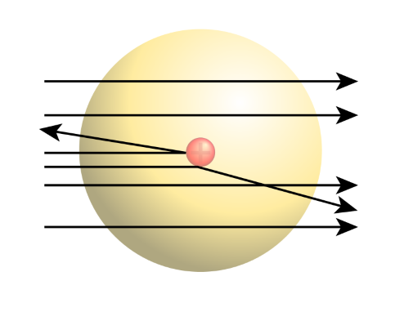
History of Particle Physics: Rutherford’s experiment
Rutherford observed that a few particles were having a huge deflection (> 90º)
He wondered what was the origin of such a strong force able to invert the sense of the particles
The only possibility was some kind of electric force made by another very close-by particle
He concluded that the positive charge of the atom should be concentrated in small region
This is the discovery of the nucleous
The distance d should be very small to produce such a large F
$F∝\frac{q_{1}q_{2}}{d^{2}}$

Slide 10
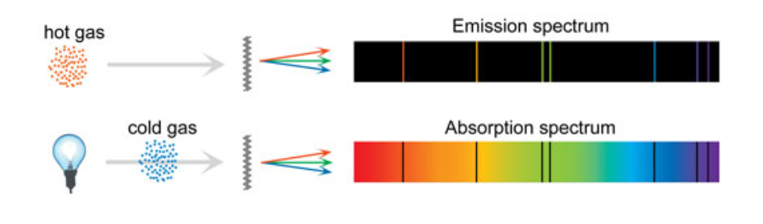
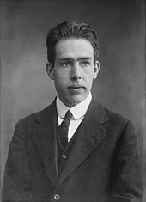
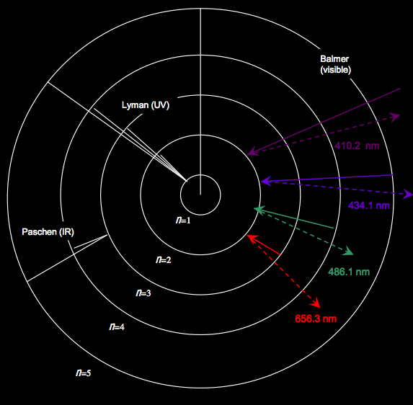
History of Particle Physics: Bohr’s atom
In 1914 Bohr proposed a “planetary” model of the atom motivated by the atomic spectrum
In this model electrons where occupying discrete orbits (quantized angular momentum)
Therefore the energies were also quantized
When a photon is absorbed one electron can jump from one orbit to another higher orbit
The electron in a higher orbit can jump back to an empty lower orbit emitting a phton

Slide 11
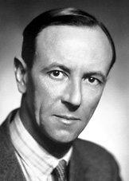
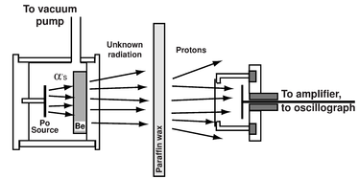
History of Particle Physics: discovery of the neutron
According to Bohr’s model the atom was composed of electrons and protons
However the mass of most of the atoms was not consistent with this assumption
To account for the atom mass, nuclei should contain neutral particles with mass ~ proton
In 1932, Chadwick proposed an experiment to identify this kind of radiation: the neutrons

Slide 12
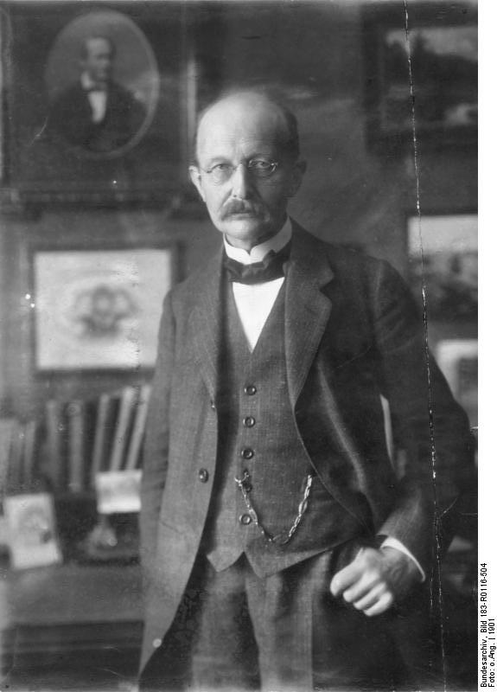
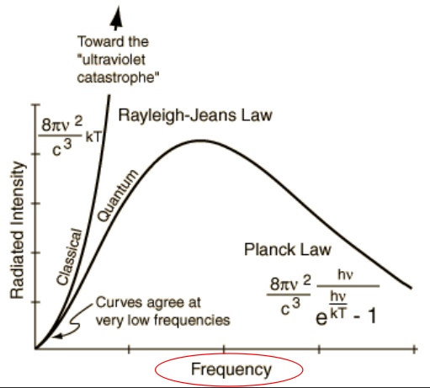
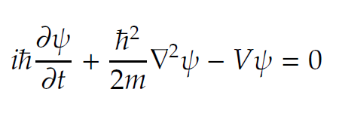
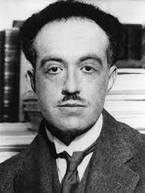
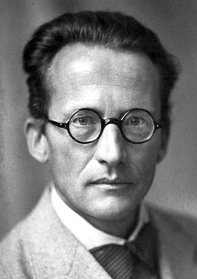
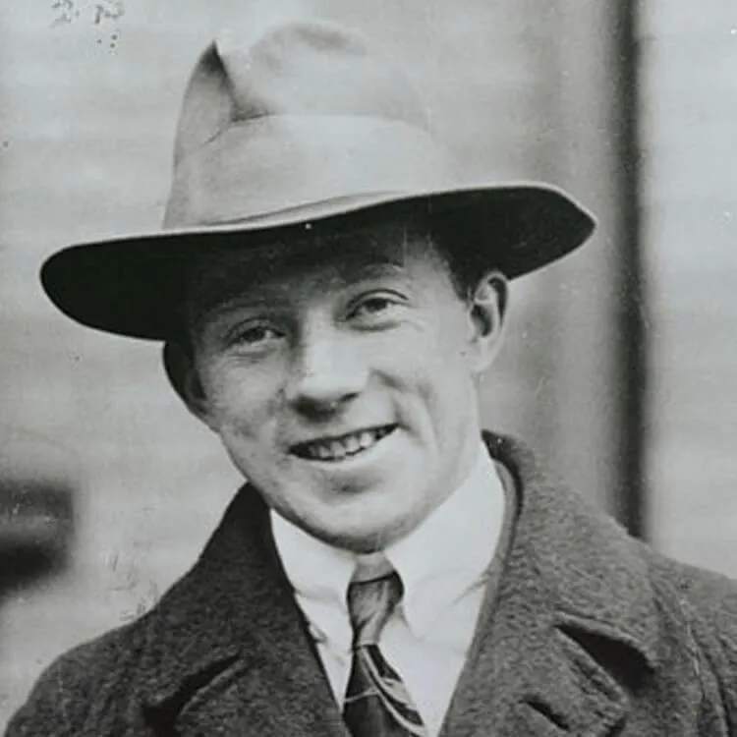
History of Particle Physics: quantum mechanics
In the first decades of the XX century the foundations of quantum mechanics are established
The first step was the explanation of the radiation of the black body by Max Planck
Light is emitted in “quanta” of discrete energy → the photon
In this period De Broglie postulates the wave-particle duality
Schrödinger and Heisenberg establish the foundations of quantum mechanics
A new vision of the atom (Schrödinger’s hydrogen atom) is established

Slide 13
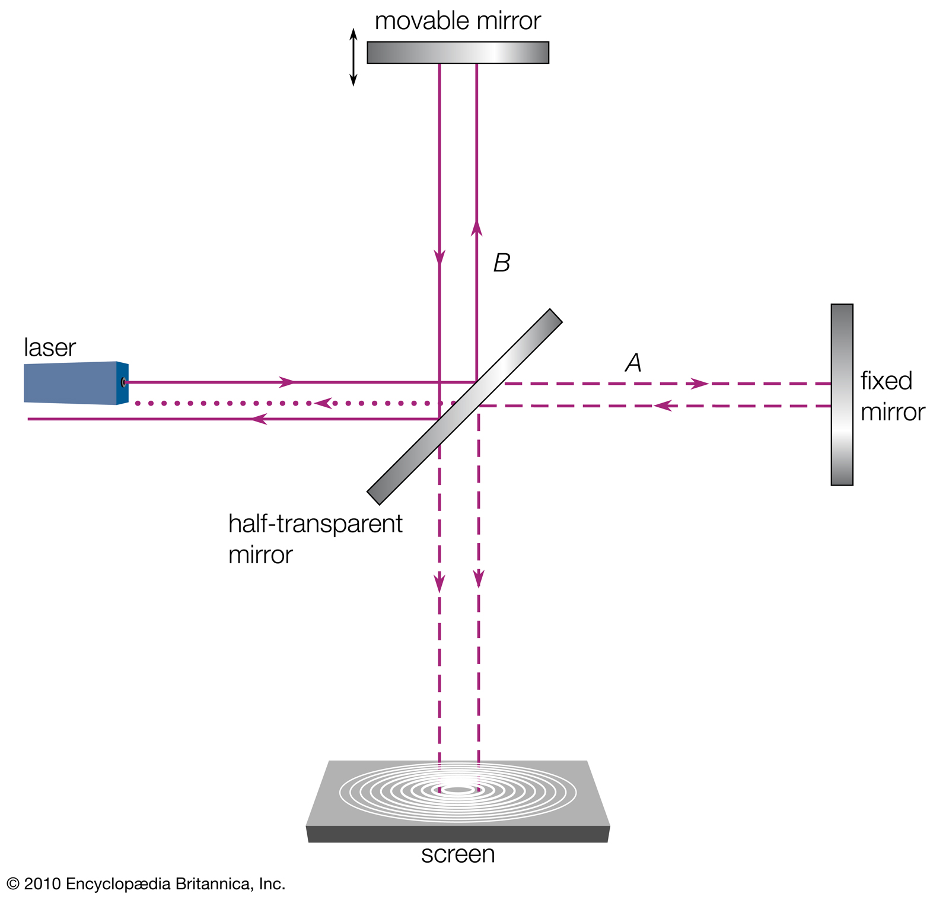
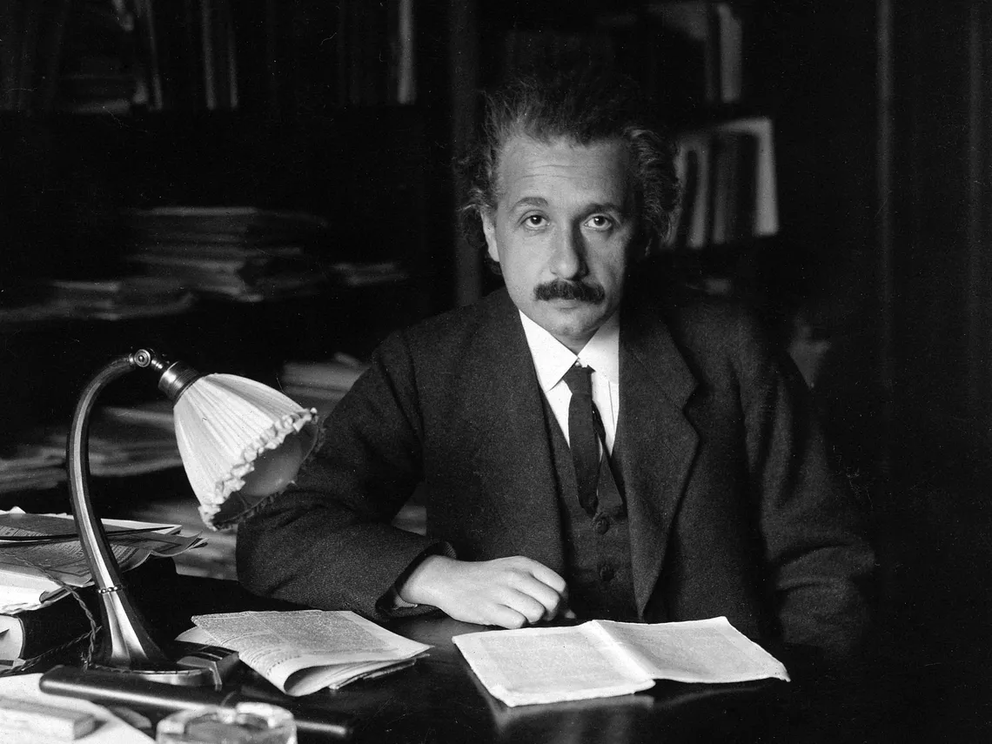
History of Particle Physics: special relativity
In the first decades of the XX century Einstein revolutionized the concepts of space and time
Galilean transformations worked for classical mechanics but not for Maxwell’s equations
A new set of transformations was needed → the Lorentz transformations
Einstein interpreted these transformations creating a new entity, the space-time
Inertial systems are those related by Lorentz transformations
The speed of light is the same in all the systems
This was confirmed by the experiment of Michelson-Morley

Slide 14
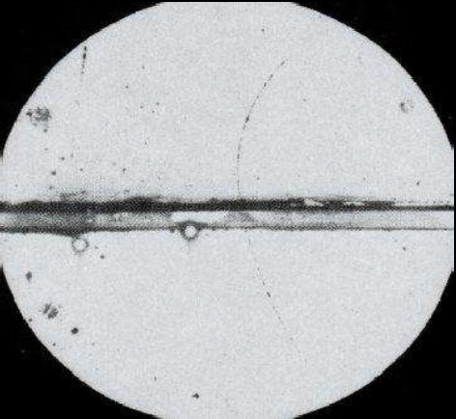
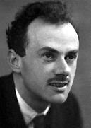
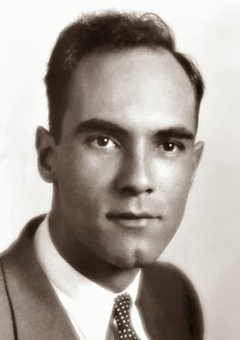
History of Particle Physics: antimatter
In 1927 Paul Dirac was trying to combine quantum mechanics with special relativity
Obtain a quantum-mechanics wave equation starting from
This lead to a problem since this relation yields to negative energy solutions
$E^{2}=p^{2}c^{2}+m^{2}c^{4}$
$E=+\sqrt{p^{2}c^{2}+m^{2}c^{4}}$
$E=−\sqrt{p^{2}c^{2}+m^{2}c^{4}}$
Dirac interpreted the positive solutions as ordinary particles and the negative as antimatter
In 1932 Anderson observed for the first time the anti-electron confirming Dirac’s theory

Slide 15
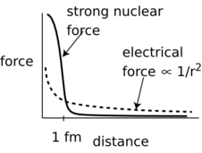
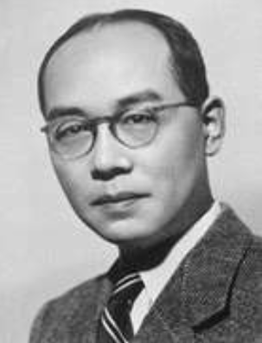
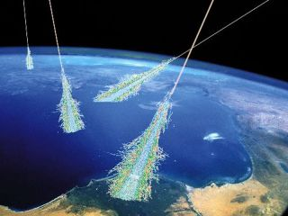
History of Particle Physics: the particle zoo
The new ideas of quantum mechanics were rapidly applied to related phenomena
The fact that the nucleus is not breaking apart due to electric repulsion suggested a new force
Yukawa was able to describe a working potential for this force
Same as photons were driving the EM force, other particle should drive this strong force
In 1936 physicist studying cosmic ray radiation found a candidate for this particle
By 1937 they found this particle was not related to the strong force → it was the muon
In 1947 the study of cosmic radiation lead to another particle: the pion

Slide 16
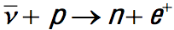
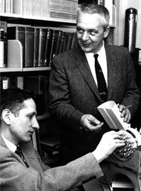
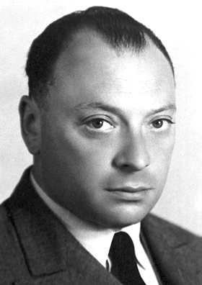
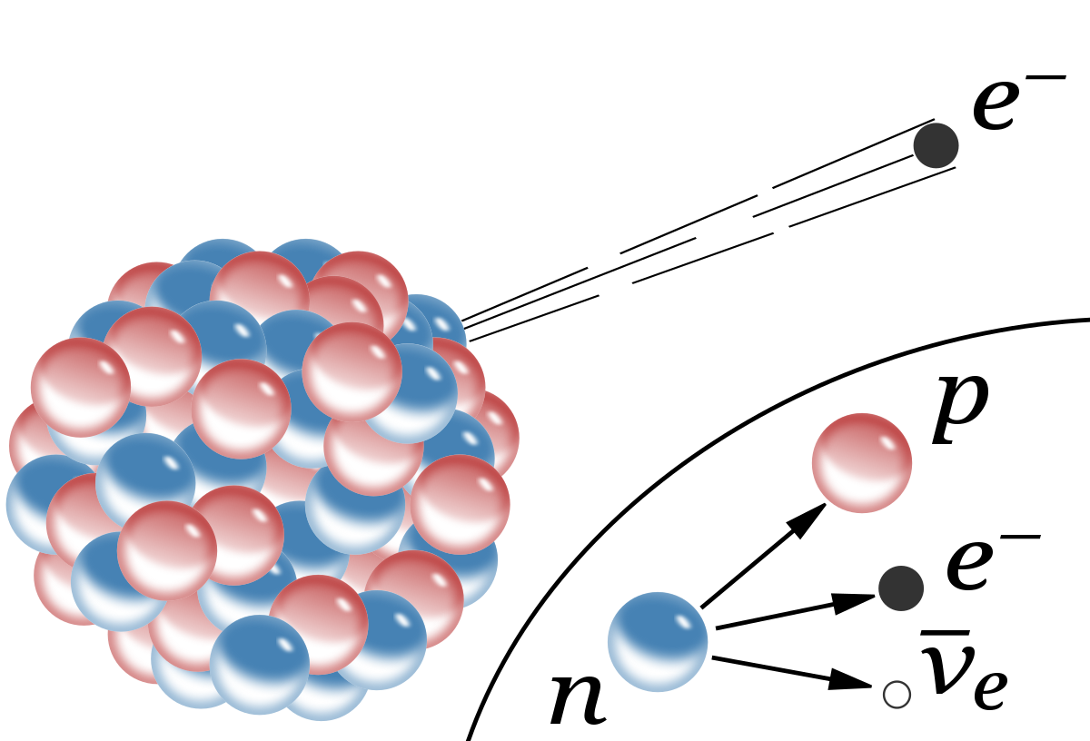
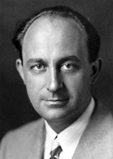
History of Particle Physics: neutrinos
The study of radioactive decays (beta decays) suggested a possible non-conservation of energy
Pauli interpreted this phenomenom by postulating a new non-detectable additional particle
In 1932 Fermi included this idea in his theory of nuclear decays
In 1950, Cowan and Raines managed to design an experiment to detect neutrinos (indirectly)
The idea was to use an inverted beta decay

Slide 17
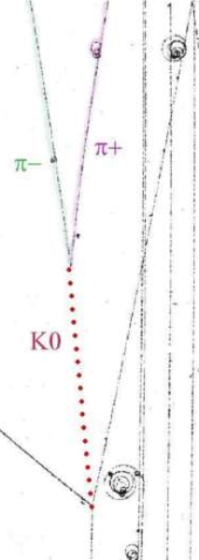
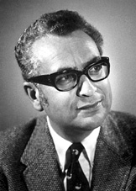
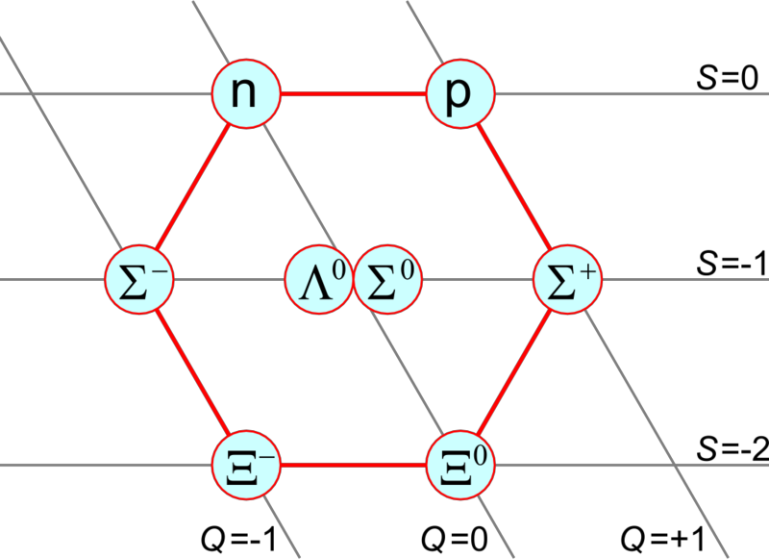
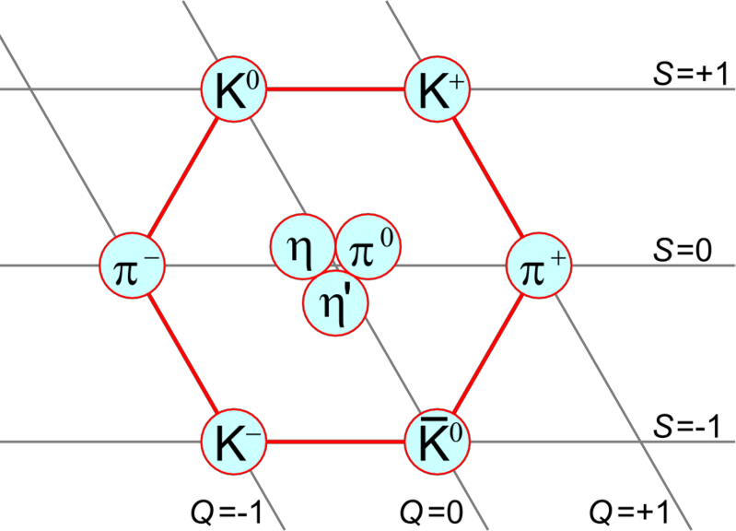
History of Particle Physics: mesons and barions
In the next years experiments in different accelerators found new mesons and barions
In 1947 several observations were made of a neutral particle decaying into 2 pions
This was the neutral kaon (K⁰)
In 1949 observations of a charged particle decaying into 3 pions
This was the charged kaon (K^{+/-})
In the next years many others: the phi, eta, omega, etc
In 1950 first evidences of barionic particles such as the Lambda
Gell-Mann realized that geometrical pattern emerged when organizing the new mesons and barions in terms of the strangeness and charge
^{Baryon Octet}
Meson Nonet

Slide 18
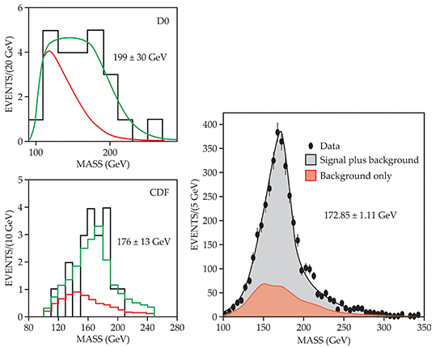
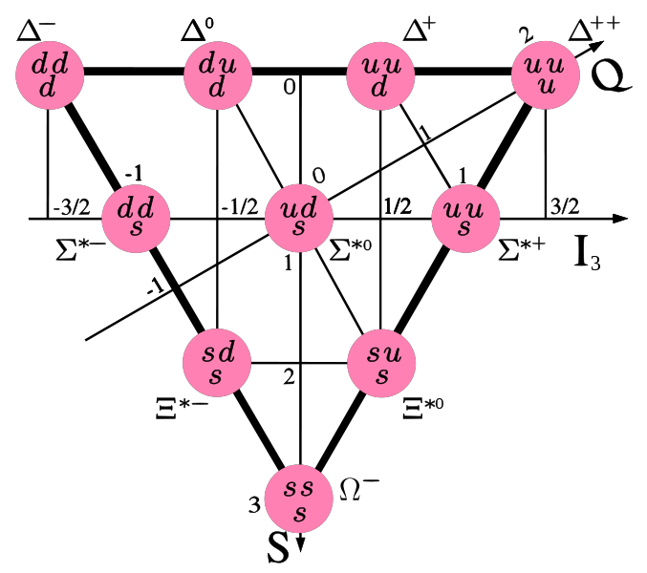
History of Particle Physics: the quark model
In 1964 Gell-Mann and Zweig proposed an explanation for the observed patterns
All hadrons are composed of more fundalmental particles: quarks
The quarks came in three types “up”, “down” and “strange” and they had fractional charge
Barions are composed by three quarks while mesons only by two quarks
However quarks cannot be found isolated in nature (confinement)
In the following years the charm, bottom and finally in 1995 the top quark were discovered

Slide 19
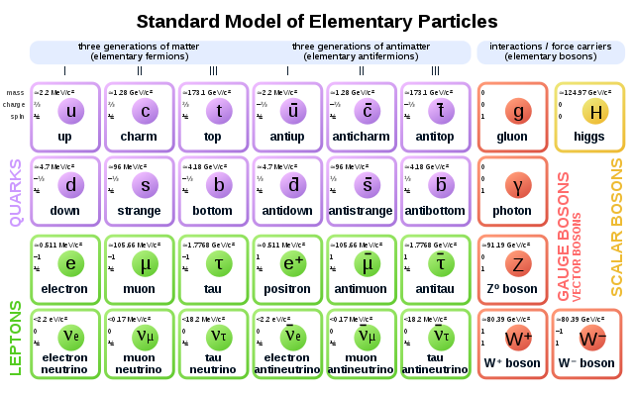
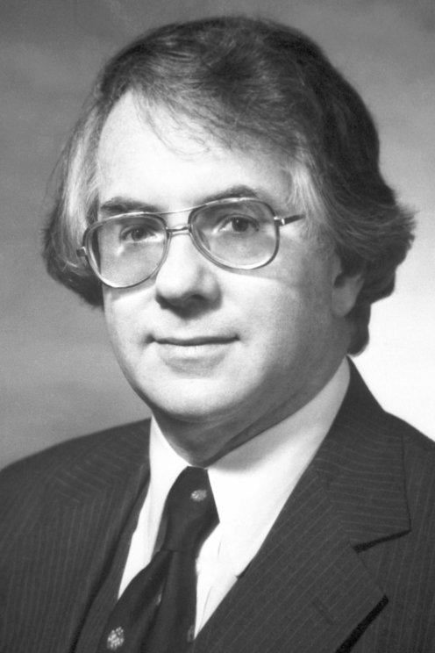
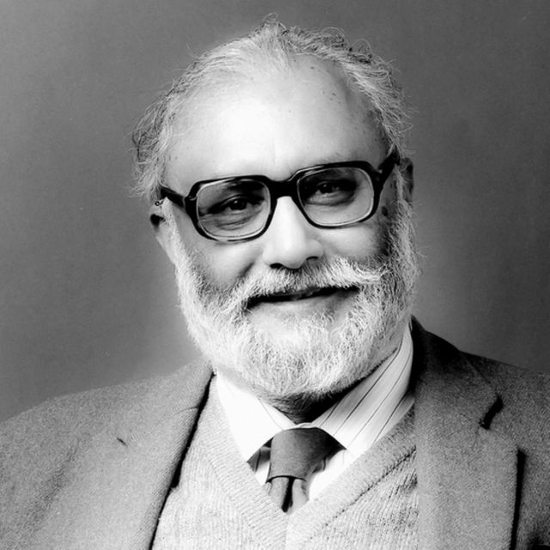
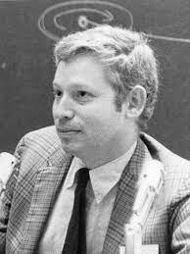
History of Particle Physics: the Standard Model
In the late sixties Glashow, Salam and Weinberg developed a model of the electrowek force
It included the recently proposed Higgs mechanism for which massive bosons acquire mass
The W and Z massive bosons were disvered in 1983 at CERN
The strong interaction was introduced and the term Standard Model was coined in 1975

Slide 20
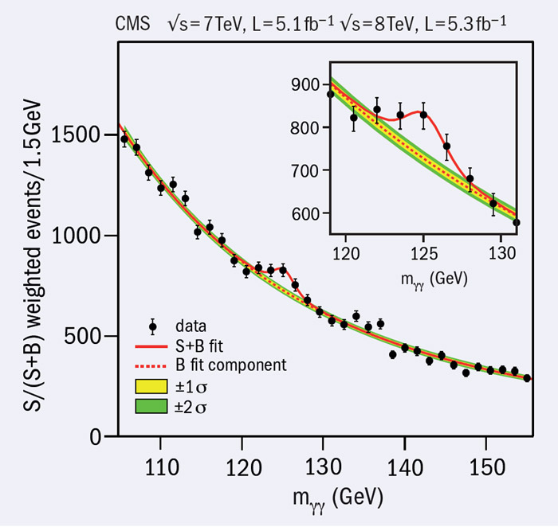
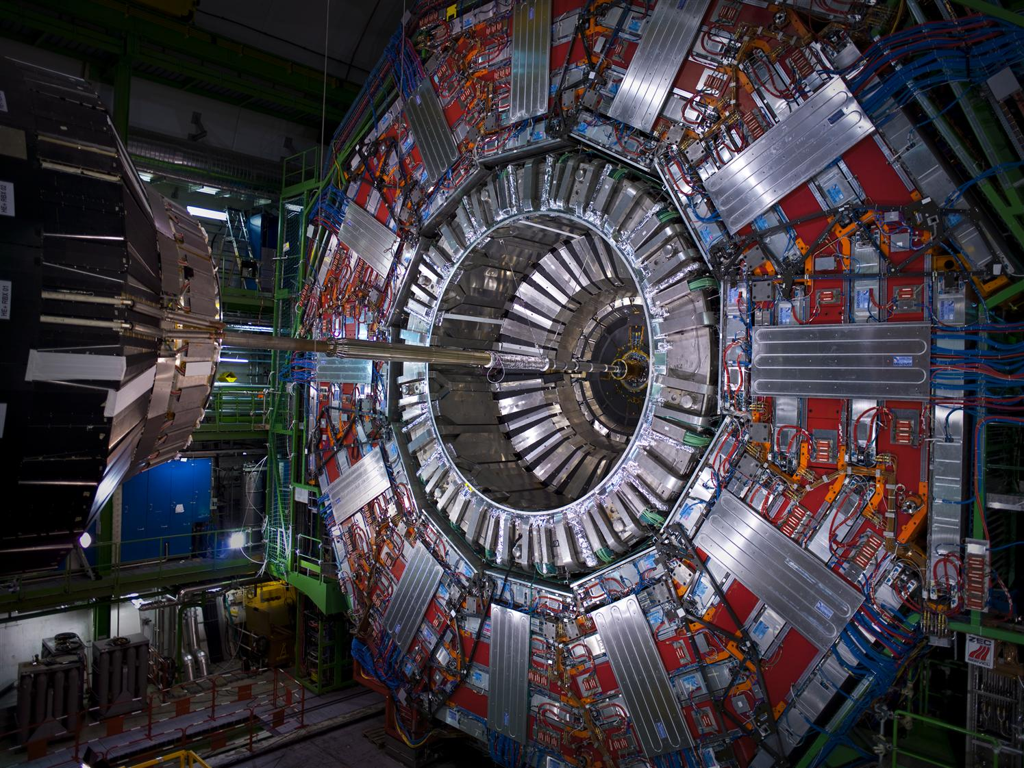
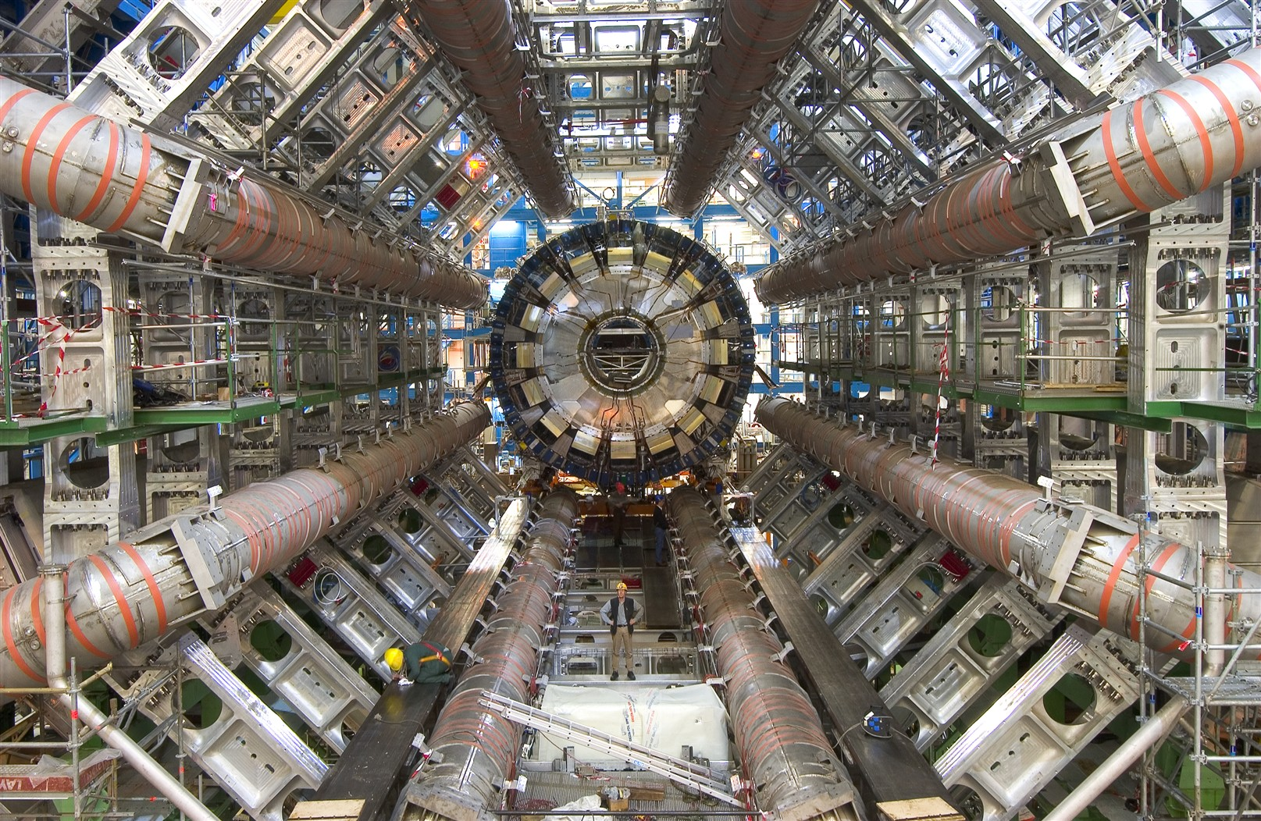

History of Particle Physics: the Higgs boson
In 2012 the Higgs boson was discovered at the Large Hadron Collider at CERN

Slide 21
Particle Physics: Natural units
The International System of Units is a natural choice for everyday objects
However is not very useful for Particle Physics where the scales are very very different
In Particle Physics we use the Natural Units:
From Quantum Mechanics – the unit of action: ℏ = 6.6 x 10⁻²⁵ GeV s
From relativity – the speed of light: c = 3 x 10⁸ cm/s
From Particle Physics – unit of energy: GeV (1 GeV ~ proton mass)
Simplified in the equations by setting ℏ =c =1
In this context the main units become :
Energy | GeV | Energy | GeV
Momentum | GeV/c | Momentum | GeV
Mass | GeV/c² | Mass | GeV
Time | (GeV/ℏ)⁻¹ | Time | GeV⁻¹
Length | (GeV/ℏc)⁻¹ | Length | GeV⁻¹
Area | (GeV/ℏc)⁻² | Area | GeV⁻²

Slide 22





Theory of Special Relativity (I) (reminder)
Galilean transformations of velocity worked very well for classical mechanics
The dynamics of the system were the same regardless the inertial system of reference
However this statement was not true for the Maxwell’s equations
A new set of transformations was needed in order to achieve this (Lorentz transformations)
Galilean transformations
Lorentz transformations
A consecuence of this transformations is that the speed of light is the same in every system
And this fact has non-intuitive implications in our conception of space and time
Einstein understood this by exploring first the concept of simultaneousty
Are events simultaneous in one system of reference simultaneous in other systems?
Einstein established that space and time were concepts attached to a same entity: space-time

Slide 23




Theory of Special Relativity (II) (reminder)
Einstein’s special relativity establishes that:
Events in the Universe are encoded by a 4-vector: (x⁰ = ct, x¹ = x, x² = y, x³ = z)
The coordinates between intertial systems of reference are give by Lorentz Transformations
For two events x and y the product: x⁰y⁰-x¹y¹-x²y²-x³y³ is invariant under transformations
In modern notation, Lorentz transformations are expressed as a tensor
Define the contravariant x^{μ}=(x⁰, x¹, x², x³) and covariant x_{μ}=(x₀, -x₁, -x₂, x₃) 4-vectors
They are related through the so-called metric tensor: x^{μ}=g^{μν}x_{ν}
Lorentz transformations can be expressed as: x’^{μ}=η^{μν}x_{ν}
This concepts can also be applied to differential operators:

Slide 24




Theory of Special Relativity (III) (reminder)
From the point of view of the dynamics, Einstein’s special relativity establishes that:
Energy and momentum in different systems transform as well with Lorentz transformations
The energy of an object moving with speed v is given by E = γmc²
Energy and momentum can also be represented by co-(contra) variante 4-vectors
This is the so called 4-momentum: p^{μ}= (p⁰= E, p¹=p_{x}, p²=p_{y}, p³=p_{z})
The energy-moment relation is given by E² = p² + m² (natural units)
It’s important to notice that for a particle with a given momentum:
In general the notation is abbreviated in such a way that:
P^{μ}P_{μ}is simply denoted as P²
P^{μ}Q_{μ} is simply denoted as PQ
Mandelstam’s invariants

Slide 25
Quantum Mechanics (I) (reminder)
Physical states (particles) are represented by wave functions Ψ(x,t)
This wave functions assign a number (or numbers) to every point of space-time
We often use the “bra”-”ket” notation for wave functions Ψ → |Ψ>
Wave functions belong, mathematically, to a structure called Hilbert space
To keep it short: it is a sort of vectorial space with some additional properties
An inner product is defined assigning a complex number to every two wave functions
The product has several good properties
$\left\langle ψ | Φ\right\rangle =awitha∈ℂ$
$\left\langle ψ | Φ\right\rangle ={\left(\left\langle Φ | ψ\right\rangle \right)}^{c}$
C = conjugate
$\left\langle ψ | a_{1}Φ_{1}+a_{2}Φ_{2}\right\rangle =a_{1}\left\langle Ψ | Φ_{1}\right\rangle +a_{2}\left\langle Ψ | Φ_{2}\right\rangle$
$\left\langle ψ | ψ\right\rangle ⩾0$
The product in Quantum Mechanics is defined as:
$\left\langle ψ | Φ\right\rangle =\int{ψ^{c}}Φ{dx}^{3}$

Slide 26
Quantum Mechanics (II) (reminder)
Wave functions are interpreted in terms of probabilities
The probability of finding a particle in the state Ψ in the region of space C is given by:
$Prob\left(x∈C\right)=\int_{C}{ψ^{c}}ψ{dx}^{3}$
Therefore the term Ψ^{c}Ψcan be associated with a density of probability
In consequence, wave functions must be normalized in such a way that:
$Prob\left(x∈ℝ^{3}\right)=\int_{∞}{ψ^{c}}ψ{dx}^{3}=1$
Physical states are often described in terms of an orthonormal basis of the Hilbert space
$ψ=\sum_{i}{a_{i}}Φ_{i}witha_{i}∈ℂ$
$\left\langle Φ_{i} | Φ_{j}\right\rangle =δ_{ij}$
The contribution of the element of the basis i is given by the product:
$\left\langle Φ_{i} | ψ\right\rangle =\left\langle Φ_{i} | \sum_{j}{a_{j}}Φ_{j}\right\rangle =\sum_{j}{a_{j}}\left\langle Φ_{i} | Φ_{j}\right\rangle =\sum_{j}{a_{j}}δ_{ij}=a_{i}$

Slide 27
Quantum Mechanics (III) (reminder)
Physical observables in Quantum Mechanics are represented by (anti)linear, unitary operators
An operator is an object that transforms a state of the Hilbert space into another
$Ψ=UΦ$
Using the properties of the wave functions we can work with operators in products:
$\left\langle Φ | UΦ\right\rangle ={\left(\left\langle UΦ | Φ\right\rangle \right)}^{c}=\left\langle U^{h}Φ | Φ\right\rangle =\left\langle Φ | UΦ\right\rangle$
h = hermitian
If the operator represents a physical state their transformed fields should be physical
$1=\left\langle Φ | Φ\right\rangle =\left\langle Uψ | Uψ\right\rangle =\left\langle ψ | U^{h}Uψ\right\rangle =1⇒U^{h}U=I$
When an observable is measured in the lab an eigenvalue of the operator is always found
$Aψ_{j}=a_{j}ψ_{j}$
If a state is expressed in terms of the eigenstates of an operator, the probability of measuring the eigenvalue a_{j} is given by:
$Φ=\sum_{i}{p_{i}}ψ_{i}⇒prob\left(findinga_{j}\right)={\left(\left|p_{j}\right|\right)}^{2}={\left(\left|\left\langle ψ_{j} | Φ\right\rangle \right|\right)}^{2}$

Slide 28
Lagrangian Formalism (I) (reminder)
Classical mechanics can be formulated using the Lagrangian Formalism
The Lagrangian is a function of the position and velocity of the particles
It is defined as L = T – V where T is the kinetic energy and V the potential energy
The action is the integral of the Lagrangian with respect to time
$S=\int_{−∞}^{∞}{L}\left(x,v\right)dt$
Physical trajectories for x and v are those for which S in a stationary state
This condition can be applied by differentiating and equaling to 0
$δS=0$
Notice that S is not a function but a functional: it assigns a number to every x(t) and v(t)
The physical x(t) and v(t) functions are those satisfying that condition
The equations of motion of a dynamical system can be derived from here

Slide 29
Lagrangian Formalism (II) (reminder)
Lagrangian formalism is valid for Quantum Field Theory although:
Position and velocity are replaced by the fields and their derivatives
A new quantity known as the “Lagrangian Density” is defined as:
$L=\int{L_{d}}\left(Φ,∂_{μ}Φ\right){dx}^{3}$
With this new quantity the action can be expressed with the following form:
$S=\int{L_{d}}\left(Φ,∂_{μ}Φ\right){dx}^{4}$
It is possible to differentiate the action (assuming good properties on the fields functions)
$δS=\int{\frac{∂L_{d}}{∂Φ}δΦ+\frac{∂L_{d}}{∂\left(∂_{μ}Φ\right)}δ\left(∂_{μ}Φ\right){dx}^{4}}=\int{\frac{∂L_{d}}{∂Φ}δΦ+\frac{∂L_{d}}{∂\left(∂_{μ}Φ\right)}∂_{μ}\left(δΦ\right){dx}^{4}}$
Applying the rule of the derivative of the product:
$∂_{μ}\left(\frac{∂L_{d}}{∂\left(∂_{μ}Φ\right)}δΦ\right)=∂_{μ}\left(\frac{∂L_{d}}{∂\left(∂_{μ}Φ\right)}\right)δΦ+\frac{∂L_{d}}{∂\left(∂_{μ}Φ\right)}∂_{μ}δΦ$

Slide 30
Lagrangian Formalism (III) (reminder)
Replacing this in the previous equation we can write:
$δS=\int{\frac{∂L_{d}}{∂Φ}δΦ+\left[∂_{μ}\left(\frac{∂L_{d}}{∂\left(∂_{μ}Φ\right)}δΦ\right)−∂_{μ}\left(\frac{∂L_{d}}{∂\left(∂_{μ}Φ\right)}\right)δΦ\right]{dx}^{4}}$
That can be expressed as:
$δS=\int{\left[\frac{∂L_{d}}{∂Φ}−∂_{μ}\left(\frac{∂L_{d}}{∂\left(∂_{μ}Φ\right)}\right)\right]δΦ{dx}^{4}}+\int{∂_{μ}\left(\frac{∂L_{d}}{∂\left(∂_{μ}Φ\right)}δΦ\right){dx}^{4}}$
The second term is the volume integral of a divergence through all the space time
Applying the divergence theorem: equals the integral of the vector in the surface of infinite
If the fields vanished there (they should to satisfy unitarity) the integral is 0
This means that the physical fields should make the following relation:
$δS=\int{\left[\frac{∂L_{d}}{∂Φ}−∂_{μ}\left(\frac{∂L_{d}}{∂\left(∂_{μ}Φ\right)}\right)\right]δΦ{dx}^{4}}=0⇒\frac{∂L_{d}}{∂Φ}−∂_{μ}\left(\frac{∂L_{d}}{∂\left(∂_{μ}Φ\right)}\right)=0$
Euler-Lagrange equations for quantum fields

Slide 31

Noether’s theorem
Emmy Noether made one of the most fundamental theorems of Physics
In this theorem Noether established a connection between symmetries and conservation laws
Let’s assume a differential transformation that converts one field into another in such a way:
$Φ→Φ'=TΦ$
$δΦ=Φ'−Φ$
If this transformation leaves the Lagrangian unchanged then the transformation is a symmetry
If the Lagrangian is unchanged it means that under this transformation
Let’s see the implications of this by making the derivatives of the Lagrangians
$δL_{d}=0$
$δL_{d}=\left[\frac{∂L_{d}}{∂Φ}−∂_{μ}\left(\frac{∂L_{d}}{∂\left(∂_{μ}Φ\right)}\right)\right]δΦ+∂_{μ}\left(\frac{∂L_{d}}{∂\left(∂_{μ}Φ\right)}δΦ\right)=0$
The first term vanishes because of the Eular-Lagrange equation, so:
$∂_{μ}\left(\frac{∂L_{d}}{∂\left(∂_{μ}Φ\right)}δΦ\right)=∂_{μ}f^{μ}=0⇒\frac{∂f^{0}}{∂t}=∇\vec{f}$
Integrating to all the space and applying the divergence theorem we have
$\frac{∂\int{f^{0}{dx}^{3}}}{∂t}=\int{∇\vec{f}{dx}^{3}}=0⇒Q=\int{f^{0}{dx}^{3}}=cste$

Slide 32
Gauge theories (I)
Group of theories in which the interactions are determined by a principle of invariance
A transformation of the fields that should leave the Lagrange invariant is considered
The transformed Lagrangian is calculated and observed not to be invariant
A new field (the interacting field) is added in order to achieve this invariance
Let’s consider the example of electromagnetism
As we will see the Lagrangian associated to a fermion Ψ is given by:
$L_{d}=\bar{ψ}\left(iγ^{μ}∂_{μ}−m\right)ψ$
Let’s assume a local phase transformation in between the fields, such as:
$ψ→ψ'=e^{iqα\left(x\right)}ψ$
$\bar{ψ}→\bar{ψ}'=e^{−iqα\left(x\right)}\bar{ψ}$
If we try to estimate how the Lagrangian changes we obtain
$L'_{d}=\bar{ψ}'\left(iγ^{μ}∂_{μ}−m\right)ψ'=\bar{ψ}'\left(iγ^{μ}∂_{μ}−m\right)ψ'$
$\bar{ψ}e^{−iqα\left(x\right)}\left(iγ^{μ}∂_{μ}−m\right)e^{iqα\left(x\right)}ψ+\bar{ψ}e^{−iqα\left(x\right)}\left(iq∂_{μ}γ^{μ}α\left(x\right)\right)e^{iqα\left(x\right)}ψ$
$\bar{ψ}\left(iγ^{μ}∂_{μ}+iqγ^{μ}∂_{μ}α\left(x\right)−m\right)ψ$

Slide 33
Gauge theories (II)
Let’s introduce a new field A_{μ}in such a way that:
$L_{d}=\bar{ψ}\left(iγ^{μ}∂_{μ}−iqγ^{μ}A_{μ}−m\right)ψ$
Applying the transformations we obtain the same as before plus aditional terms:
$L'_{d}=\bar{ψ}\left(iγ^{μ}∂_{μ}+iqγ^{μ}∂_{μ}α\left(x\right)−m\right)ψ−\bar{ψ}\left(iqγ^{μ}A'_{μ}\right)ψ$
Grouping the terms:
$L'_{d}=\bar{ψ}\left(iγ^{μ}∂_{μ}+iqγ^{μ}\left(∂_{μ}α\left(x\right)−A'_{μ}\right)−m\right)ψ$
If the introduced field transforms according to this transformation:
$A'_{μ}=A_{μ}+∂_{μ}α\left(x\right)$
The transformed Lagrangian is now exactly the same as the original Lagrangian
$L'_{d}=\bar{ψ}\left(iγ^{μ}∂_{μ}−iqγ^{μ}A_{μ}−m\right)ψ=L_{d}$
A_{μ}is the field of the photon and describes the electromagnetic interactions

